Slide 1
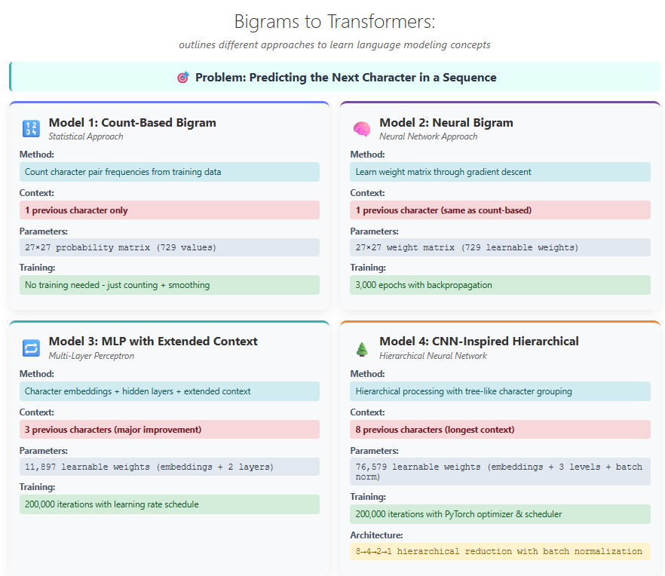
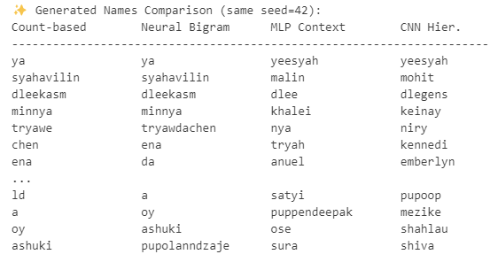

Slide 2
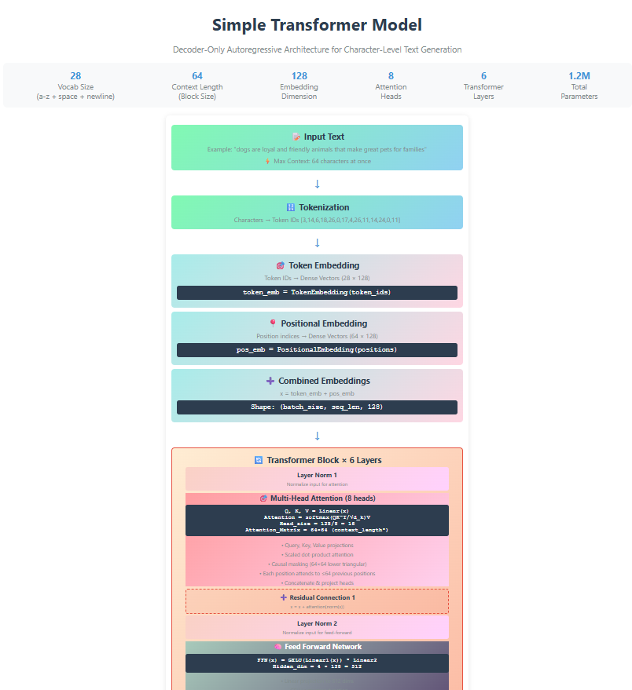
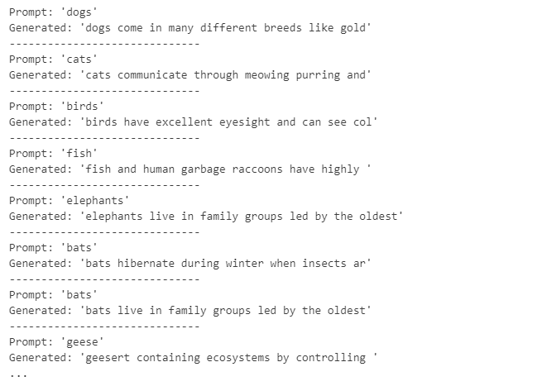

Slide 3
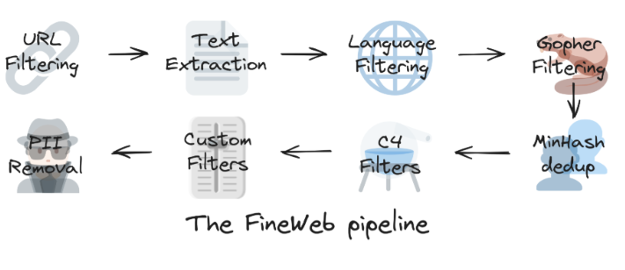
Pretraining: Data Foundations of LLMs
performance of a large language model (LLM) depends heavily on the quality and size of its pre training dataset
Where do LLMs get all that data?
🔍 Two main approaches to sourcing data:
🏢 Crawl it yourself e.g., OpenAI, Anthropic, etc.
🌐 Use public web archives like CommonCrawl, a nonprofit that releases ~200–400 TiB of raw web data monthly
🧼 Projects like 🍷 FineWeb:
Start with CommonCrawl
Apply cleaning, filtering, and deduplication
Produce high-quality pre training datasets
15-trillions (GPT2 tokenizer) ~44TB disk space

Slide 4
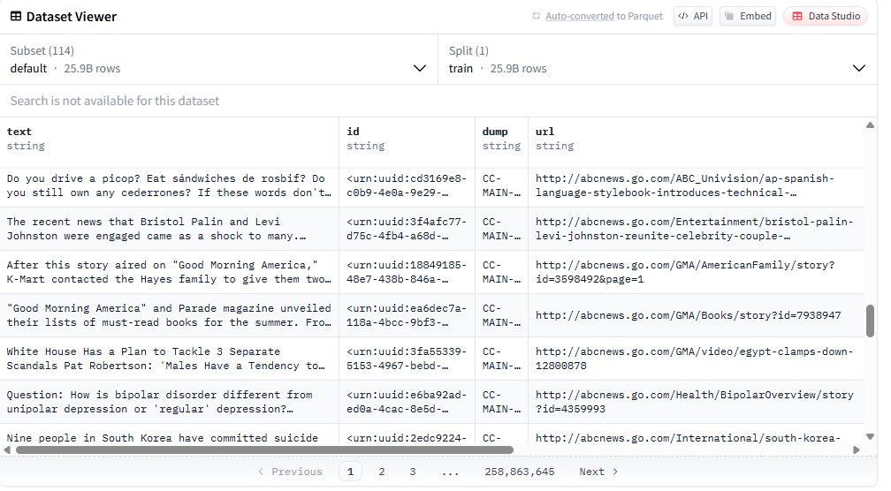
https://huggingface.co/datasets/HuggingFaceFW/fineweb
load the full dataset or a specific crawl using datatrove.pipeline

Slide 5
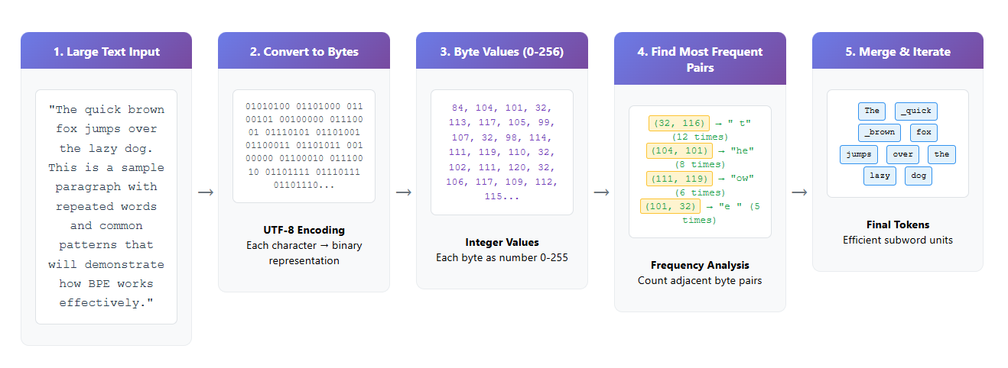
2. Tokenizations
Converts text <---> sequences of symbols (/tokens)
- Start with stream of bytes (256 tokens)
- Run the Byte Pair Encoding algorithm (iteratively merge the most common token pair to create new token)
Example: ~5000 text characters
~= 40,000 bits (with vocabulary size of 2 tokens: bits 0/1)
~= 5000 bytes (with vocabulary size of 256 tokens: bytes)
~= 1300 GPT-4 tokens (vocabulary size 100,277)
"The quick brown fox jumps over the lazy dog. This is a sample paragraph with repeated words and common patterns that will demonstrate how BPE works effectively."
https://tiktokenizer.vercel.app/?model=gpt2

Slide 6
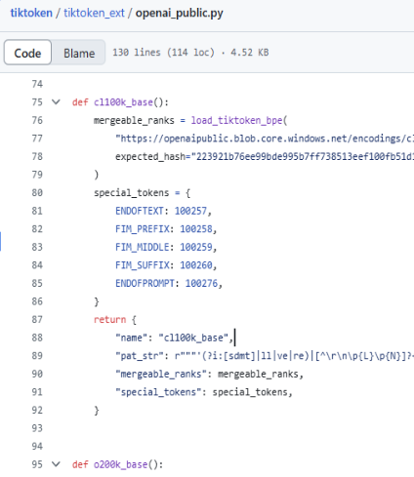
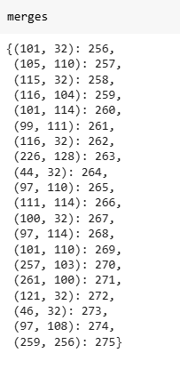
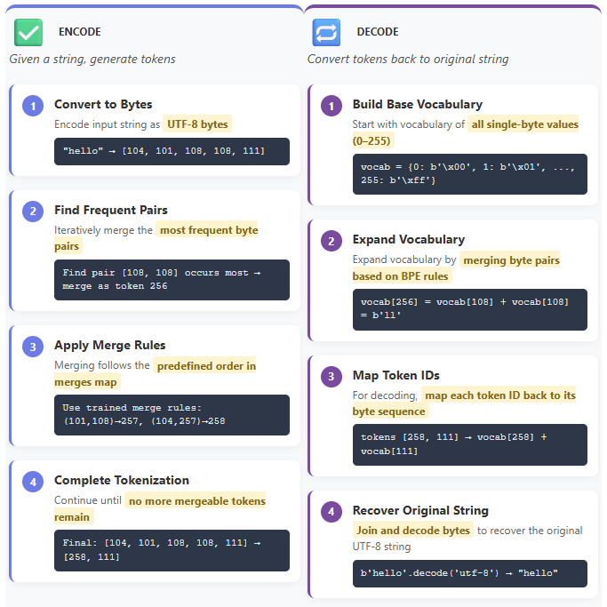
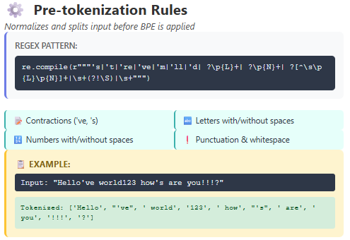

Slide 7
🔤 SentencePiece Tokenizer
Efficiently supports both training and inference for BPE tokenizers.
Used in popular models like LLaMA and Mistral.
Unlike TikToken, runs BPE directly on Unicode code points.
Offers a character_coverage setting to handle rare characters.
Rare characters can be:
Mapped to an [UNK] token, or
Encoded as UTF-8 bytes using byte_fallback.
⚖️ TL;DR Comparison with TikToken
TikToken: Converts text to UTF-8, then applies BPE on bytes.
SentencePiece: Applies BPE on Unicode code points, with optional fallback to UTF-8 bytes for rare code points.

Slide 8
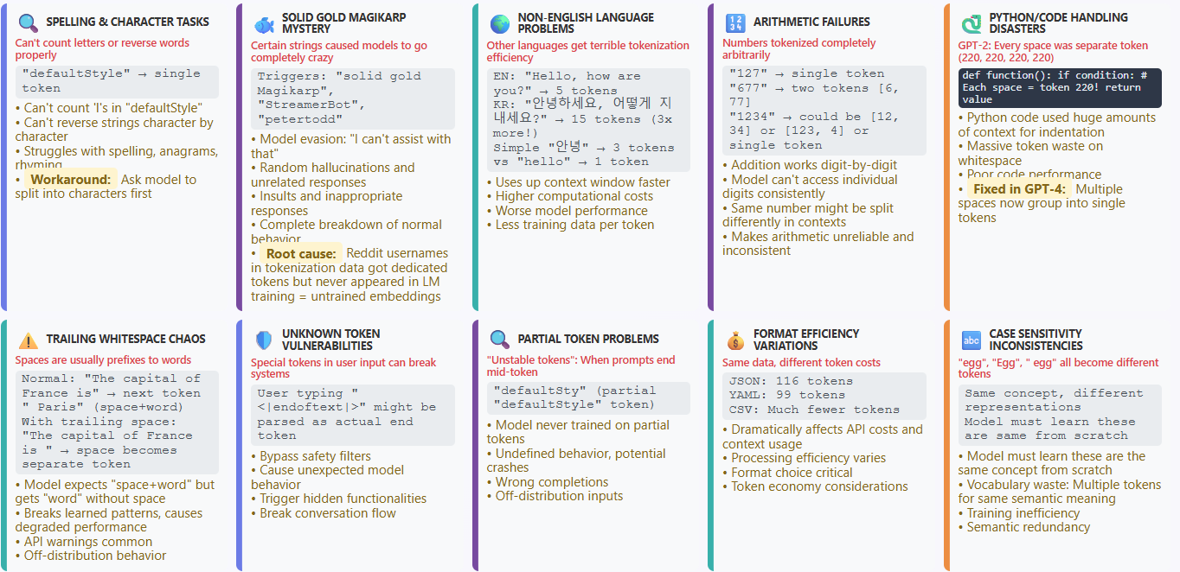
weird LLM behaviors trace back to tokenization, not the model itself!

Slide 9
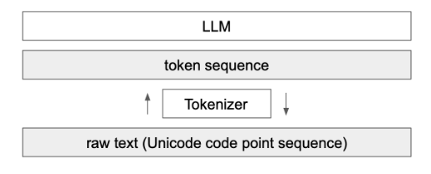
The tokenizer is a completely independent module, separate from the LLM. It has its own training dataset, which may differ from that of the LLM.
Its role is to translate raw text to a sequence of tokens and vice versa.
LLM interacts only with tokens and never directly processes the raw text.

Slide 10
base model (neural network training)
https://app.hyperbolic.ai/models/llama31-405b-base-bf-16
🧠 What is a Base LLM?
A Base LLM (Large Language Model) is trained to predict the next word (~document completer) using massive amounts of internet text and documents.
🔍 How it works:
Given a prompt, it predicts what comes next — based only on patterns it has learned. Example 1: Prompt: "Once upon a time there was a unicorn" Completion: "that lived in a magical forest with all its unicorn friends." Example 2: Prompt: "What is the capital of France?" Completion:
"What is France's largest city?"
"What is France's population?" (Why? Because it might have seen question lists, not just direct answers)

Slide 11
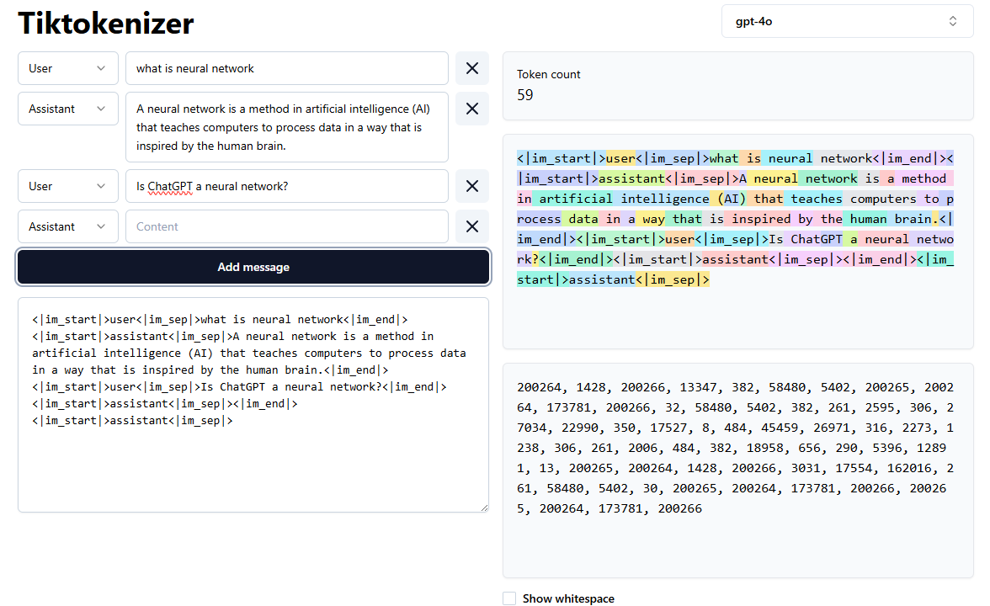
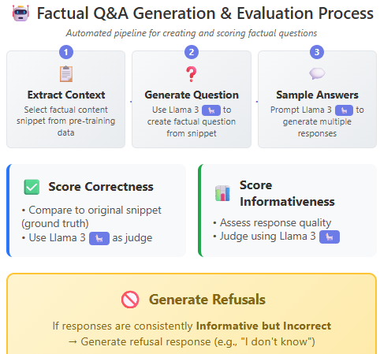
🧾 Post training
An Instruction-Tuned LLM is a language model fine-tuned to follow instructions and respond helpfully.
✅ How it's different from a Base LLM:
Prompt: "What is the capital of France?" Response: "The capital of France is Paris." (Clear, direct, helpful — unlike the base LLM)
🛠️ How it’s trained:
Fine-tuning Instruction-Tuned LLM: With examples of instructions and desired completions
im_start , im_end introduce at post training step
Hallucination - Align the model to "know what it knows"
Reinforcement Learning from Human Feedback (RLHF): Improves helpfulness and reduces harmful or toxic outputs

Slide 12
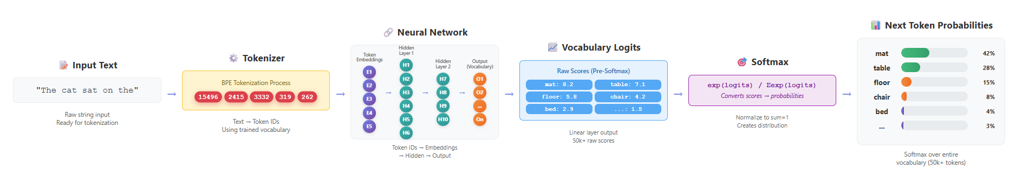

Slide 13
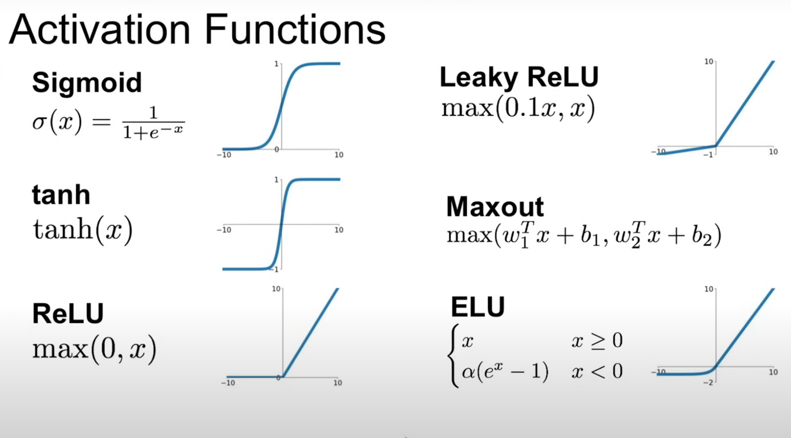
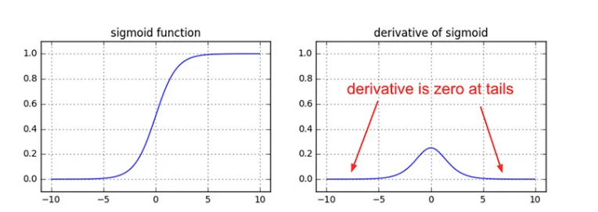
A linear model (without activation functions or with only linear activations) can only learn straight lines or flat planes.
With nonlinear activations the network can learn curved, wavy, or more irregular patterns, adapting to the data more flexibly.
🔴 Sigmoid (Problem)
Gradients vanish at the tails (when input is very positive or negative).
Causes slow learning or no learning in deep networks.
not zero-centered.
(Non-zero-centered output ⇒ Biased gradients)
Weight updates may zigzag.
Optimizer takes longer to converge.
🟡 Tanh (Better than sigmoid but not ideal)
Centered at 0, but still suffers from saturation at extreme values.
Slightly better gradient flow than sigmoid, but still problematic for deep networks.
🟢 ReLU (Solution)
Doesn't saturate for positive inputs → gradients stay strong.
Enables fast and stable training, especially in deep networks.
🟢 Leaky ReLU / ELU / Maxout (Improved Solutions)
Allow small gradients for negative inputs → avoids dying neurons.
Help maintain gradient flow and faster convergence.
Use ReLU. Be careful with your learning rates
Try out Leaky ReLU / Maxout / ELU
Try out tanh but don’t expect much
Don’t use sigmoid

Slide 14
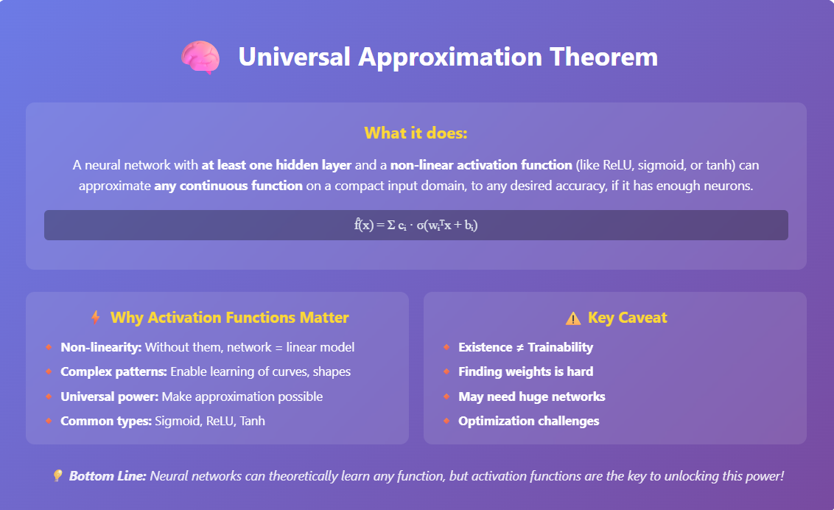

Slide 15

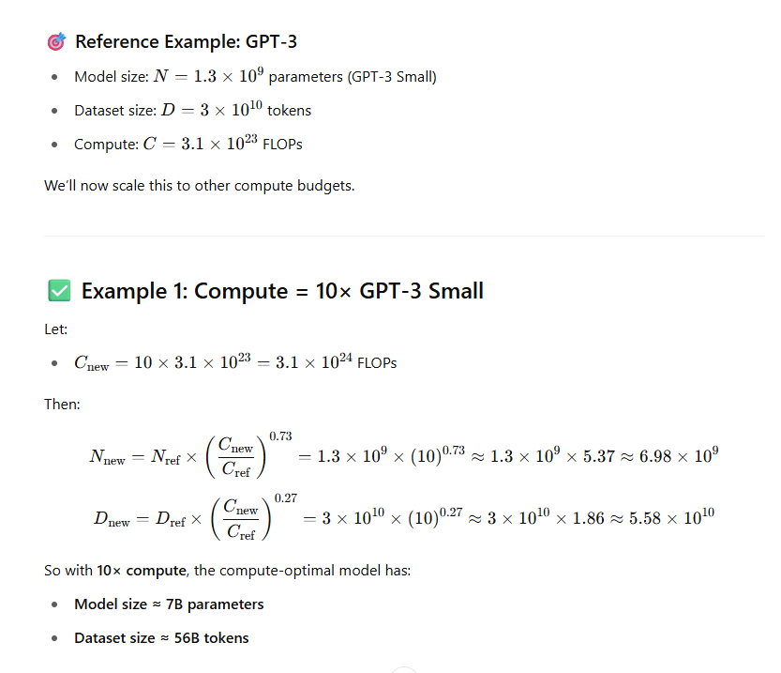

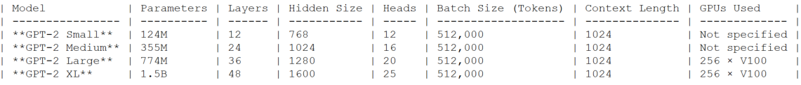
Scaling laws describe how model performance (e.g., loss, accuracy) improves as you scale up:
Model size (number of parameters)
Dataset size (number of tokens or examples)
Compute (FLOPs used during training)
As you increase model size, dataset size, and training compute, the loss decreases smoothly — often as a power law:
where N could be model size, data size, or compute, and α\alphaα is a scaling exponent.
Diminishing returns at extreme scale
Compute-optimal model size
You can predict the best model size given a fixed compute budget using scaling laws
Don’t just scale the model; scale model + data + compute in the right proportion.

